Slide 1


Introduction to Analyzing Hotel Reservation Data
Unlock valuable insights from your hotel's reservation data using SQL. This presentation will guide you through the process of setting up a MySQL database, importing the data, and executing powerful queries to uncover trends, optimize operations, and drive business growth.

Slide 2




Software Installation and Setup
Install MySQL
Download the latest MySQL Community Server for your operating system and follow the on-screen instructions to install it. This will provide the database management system needed to host the hotel reservation data.
Set Up MySQL Workbench
Install MySQL Workbench, a visual database design tool that simplifies database administration and development tasks. This will be used to create the database schema and execute SQL queries.
Configure MySQL Connection
Set up a new MySQL connection in Workbench, specifying the server host, port, username, and password. This will allow you to securely access the MySQL database from the Workbench application.

Slide 3
Preparing the Hotel Reservation Dataset
Data Extraction
1
Gather data from various hotel reservation systems
Data Cleaning
2
Remove inconsistencies and handle missing values
Feature Engineering
3
Create additional derived features for analysis
The first step in analyzing the hotel reservation dataset is to extract the relevant data from the various hotel reservation systems. This data may come in different formats and require cleaning to remove inconsistencies and handle any missing values. Once the data is cleaned, the next step is to perform feature engineering, creating additional derived features that can be useful for the analysis.

Slide 4




Creating a MySQL Database
Install MySQL
1
Download and install the latest version of MySQL on your system.
Create Database
2
Use the MySQL Command Line Client to create a new database for your hotel reservation data.
Define Tables
3
Design the database schema and create necessary tables to store the hotel reservation information.
Secure Database
4
Set up user permissions and access controls to ensure the data is protected.
With the MySQL database set up, you can now proceed to import the hotel reservation dataset and start exploring the data through SQL queries. The key steps in this process include installing MySQL, creating a new database, defining the necessary tables, and securing the database with appropriate user permissions.

Slide 5

Importing the Hotel Reservation Data
1
Extract Data
Export the hotel reservation data from the source system or database into a standardized format like CSV or Excel.
2
Create Database Table
In the MySQL database, create a new table to hold the hotel reservation data, matching the column structure of the extracted dataset.
3
Import Data
Use SQL's LOAD DATA INFILE statement to efficiently import the reservation data from the CSV or Excel file into the newly created database table.

Slide 6

Executing Basic SQL Queries
Select Statements
Retrieve specific data from the hotel reservation database using SELECT statements. This allows you to filter, sort, and aggregate information based on your analysis needs.
Where Clauses
Utilize WHERE clauses to filter the data and focus on specific criteria, such as reservations made during a certain date range or for a particular hotel location.
Aggregate Functions
Employ aggregate functions like SUM, AVG, and COUNT to gain insights into the dataset, such as total revenue, average booking value, or number of reservations.

Slide 7
Exploring Data with Advanced SQL Queries
Complex Joins
1
Combine multiple tables to gain deeper insights
Subqueries
2
Nest queries to perform multi-step analysis
Window Functions
3
Unlock powerful analytical capabilities
Once you have mastered the basics of querying the hotel reservation data, it's time to dive into more advanced SQL techniques. By leveraging complex joins, subqueries, and window functions, you can perform intricate data analysis to uncover hidden patterns, identify trends, and make data-driven decisions.

Slide 8

Utilizing Stored Procedures for Business Logic
1
Encapsulate Complex Queries
Stored procedures allow you to encapsulate complex SQL queries into reusable components, making your code more modular and maintainable.
2
Improve Performance
By pre-compiling SQL statements, stored procedures can significantly improve query execution times, especially for frequently run business logic.
3
Enhance Data Security
Stored procedures help enforce data access controls and minimize the risk of SQL injection attacks by isolating the database logic.

Slide 9



Visualizing Query Results with Screenshots
Hotel Occupancy Statistics
Hotel Revenue Trends
Customer Booking Patterns
Interactive data visualizations generated from SQL queries provide powerful tools for analyzing and presenting hotel financial performance.
Query results can be effectively visualized using screenshots that display key metrics and insights in a clean, easy-to-interpret format.
Displaying SQL query results as screenshots allows stakeholders to quickly understand customer behavior and booking trends for the hotel.

Slide 10

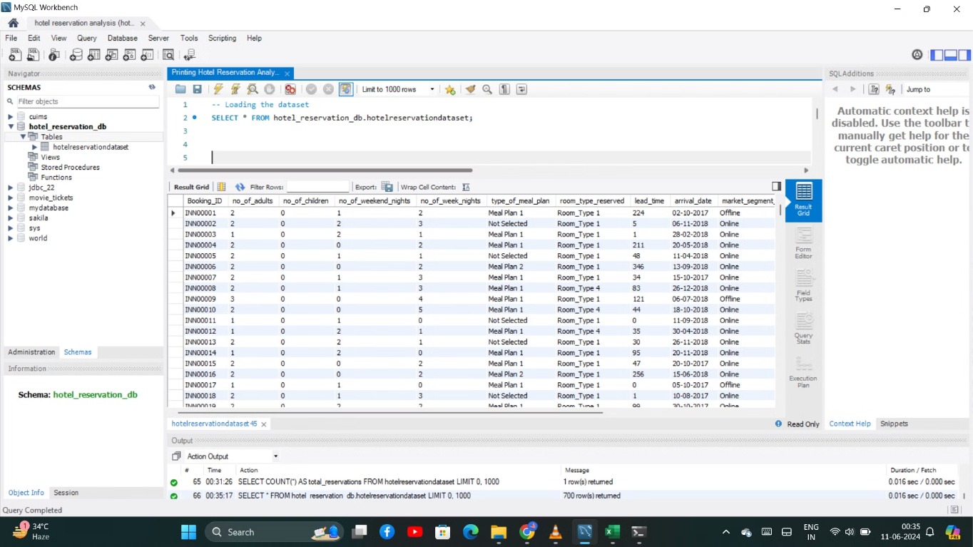

Slide 11

Conclusion and Key Takeaways
Streamlined Analysis Workflow
SQL Power for Business Intelligence
By leveraging MySQL and a well-structured hotel reservation dataset, you can establish an efficient, scalable data analysis process to uncover valuable insights.
The combination of SQL queries, including advanced techniques like stored procedures, empowers you to tackle complex business questions and make data-driven decisions.
Impactful Data Visualization
Integrating screenshots of your SQL query results allows you to communicate your findings clearly and compellingly to stakeholders.

